Slide 1
COURSERA CAPSTONE PROJECT: Selection of a location for a Russian restaraunt in Tokyo
By Andrey Slyadnev
August 3, 2020

Slide 2
Background
Tokyo metropolis is one of the most populous metrapolian areas in the word with more than 13.9 million residents as of 2019. Occupying the area of 2,194km2, it consisits of 23 special wards, 26 cities, 1 district and 4 subprefectures. The metropolis is well known for its highly developed and very competitive food service industry which has been given a considerable boost in anticipation of the 2020 Summer Olympics that Tokyo was going to host.
The purpose of this project is to acquire data on Tokyo restaurant venues, allocate venues to corresponding clusters with a focus on ethnic type venues. In particular, this research should help understand how many Russian food restaurants are available throughout the area and if there is any room for a new Russian restaurant.

Slide 3
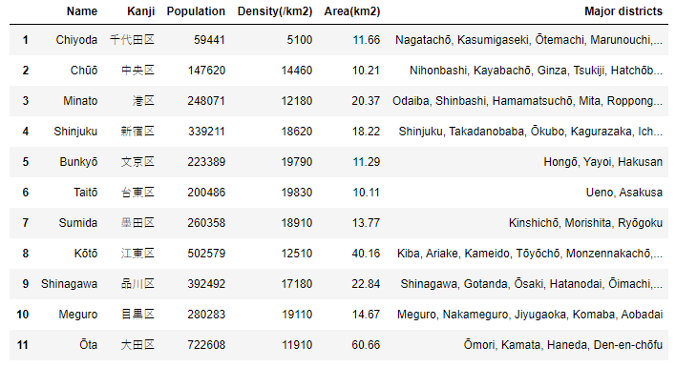
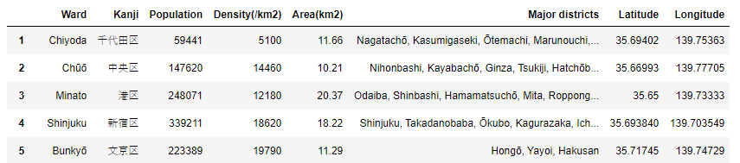
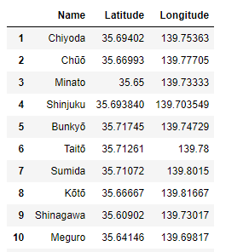
Data acquisition and wrangling
The initial data was be obtained via Wikipedia, the Foursquare API and other internet resources.
The core data on 23 Tokyo Wards was scraped from Wikipedia, please refer to https://en.wikipedia.org/wiki/Special_wards_of_Tokyo. It was, however, impossible to locate a web source containing all necessary decimal geographic coordinates. As a result, latitude and longitude of the Wards were acquired via a manual internet search, added to a separate dataset, which was then merged the Wards dataframe

Slide 4
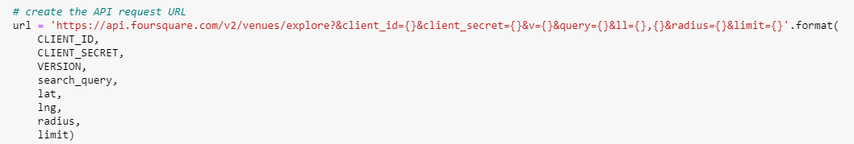
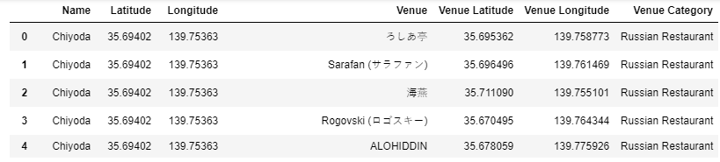
Data acquisition and wrangling
The Foursquare API was applied to make calls for Russian restaurants located within a 4,000m radius of every Ward location

Slide 5
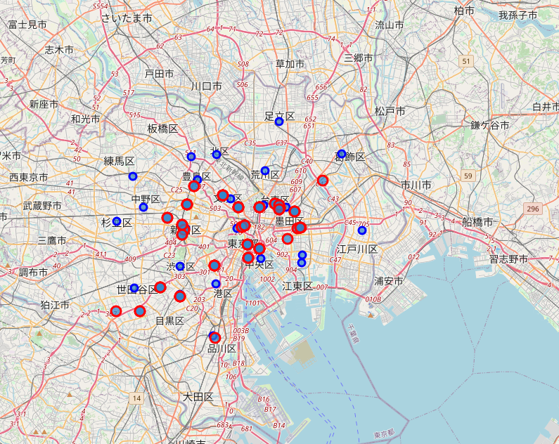
Study results
The result of the aforementioned study was a map of the Tokyo metropolitan area with plotted Russian food venues, which makes it easy visualize their spatial distribution.
At this point, no machine learning techniques could be applied yet as it was difficult to acquire all the required data (e.g. the total number of food and drink venues per ward). However, if these data become available, it should be possible to make a model to predict the potential growth of food and drink venues in different Tokyo wards by considering the ratio of the number of restaurants and the ward population

Slide 6
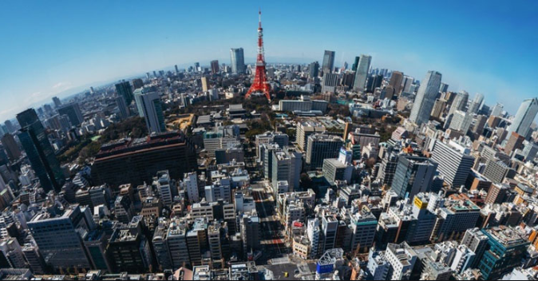
Conclusion
Selecting a location for a new restaurant in a country with the highest density of restaurants/cafeteria in the world with one restaurant for each 266 people can be quite a challenge. Data analysis techniques can help significantly narrow down the problem if not solve it.

Slide 7
THANKS!

Slide 8
CREDITS
Special thanks to all the people who made and released these awesome resources for free:
Presentation template by SlidesCarnival
Photographs by Unsplash

Slide 9
PRESENTATION DESIGN
This presentation uses the following typographies:
Titles: Saira Semi Condensed
Body copy: Inria Sans
Download for free at: https://www.fontsquirrel.com/fonts/saira https://www.fontsquirrel.com/fonts/inria-sans
You don’t need to keep this slide in your presentation. It’s only here to serve you as a design guide if you need to create new slides or download the fonts to edit the presentation in PowerPoint®

